Slide 1
Classification of Polish poetry using the Transformers architecture in the herBERT model
Nikola Janik
Supervisor: Prof. Dr. Hab. Inż. Władysław Skarbek

Slide 2
Plan:
Introduction a) Motivation and Objectives b) Tools and pipeline
Results
a) Unsupervised analysis: Dimensionality reduction and clustering analysis using PCA, t-SNE, and UMAP
b) Supervised learning - Nearest neighbour algorithm - XGBoost - Feedforward neural network
3. Conclusions and Outlook

Slide 3
Plan:
Introduction a) Motivation and Objectives b) Tools and pipeline
Results
a) Unsupervised analysis: Dimensionality reduction and clustering analysis using PCA, t-SNE, and UMAP
b) Supervised learning - Nearest neighbour algorithm - XGBoost - Feedforward neural network
3. Conclusions and Outlook

Slide 4
Motivation and Objectives
Current application of language models in literary studies:
style
social networks
thematic analysis
sentiment analysis
Qualitative and quantitative approach in literary studies:
Can machine learning models classify poetic texts written in the Polish language?
Can machine learning models capture the dependencies observed by literary scholars?
Authors:
Jan Kochanowski
Krzysztof Kamil Baczyński
Czesław Miłosz
Zbigniew Herbert
Wisława Szymborska
Halina Poświatowska
Maria Pawlikowska-Jasnorzewska
Ewa Lipska

Slide 5

Tools and pipeline
Tools:
Transformers architecture - herBERT model
TOKENIZATION
EMBEDDING
herBERT
Steps:
data preparing: tokenization, embedding
calculating Euclidean and cosine distances
dimensionality reduction
classification task
poem_{i}
[„text”]_{i}
label_{i}
{X_{i}, y_{i}}

Slide 6
Plan:
Introduction a) Motivation and Objectives b) Tools and pipeline
Results
a) Unsupervised analysis: Dimensionality reduction and clustering analysis using PCA, t-SNE, and UMAP
b) Supervised learning - Nearest neighbour algorithm - XGBoost - Feedforward neural network
3. Conclusions and Outlook

Slide 7
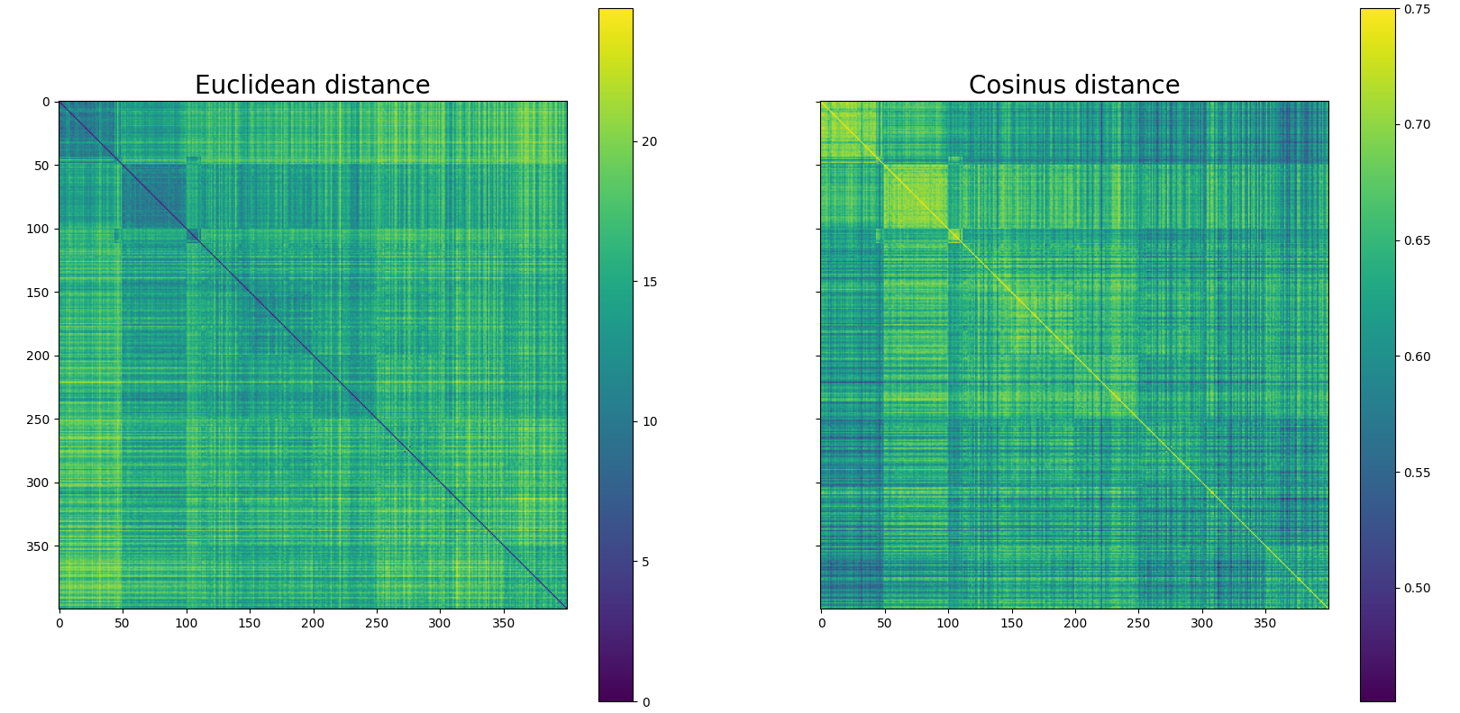
Euclidean distance and cosine similarity between embedded vectors
0-49 K. J. Kochanowski
50-99 K. K. Baczyński
100-149 Cz. Miłosz
150-199 Z. Herbert
200-249 W. Szymborska
250-299 H. Poświatowska
300-349 M. P. Jasnorzewska
350-399 E. Lipska
Euclidean distance
Cosine similarity

Slide 8
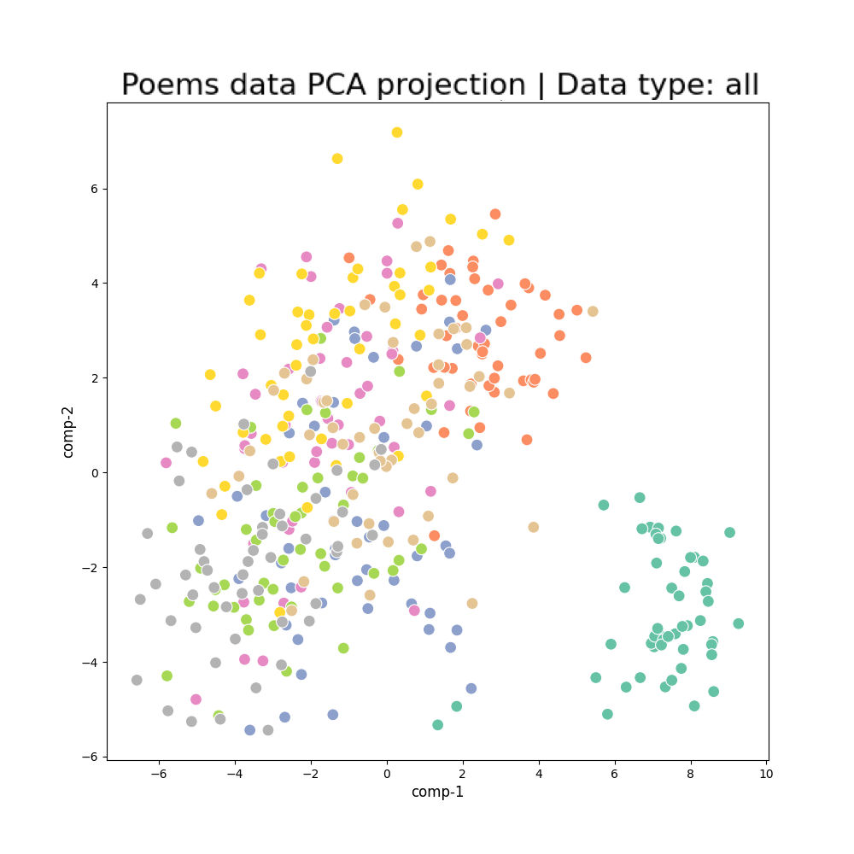
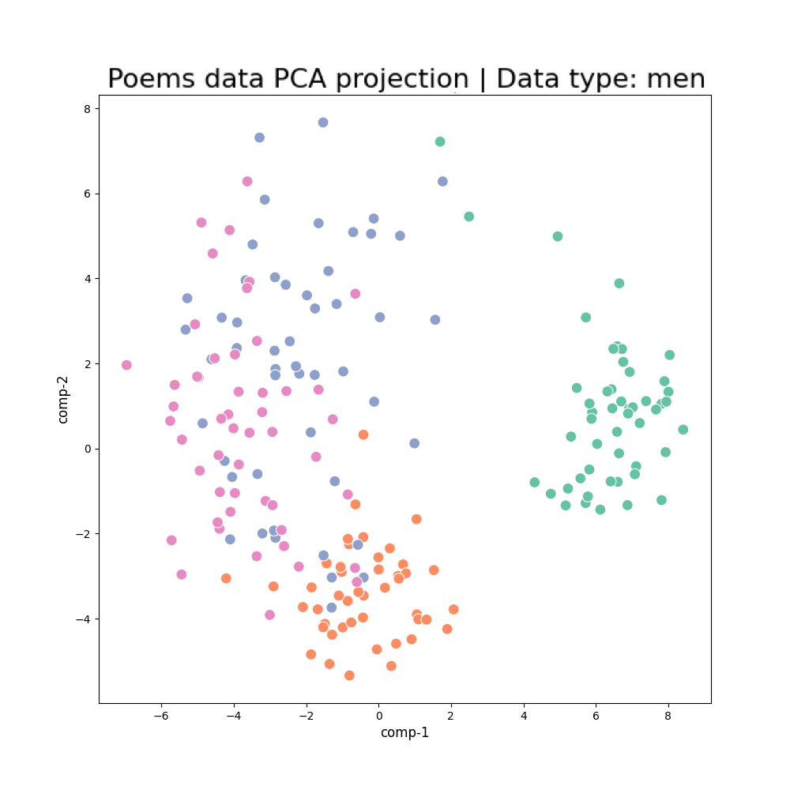
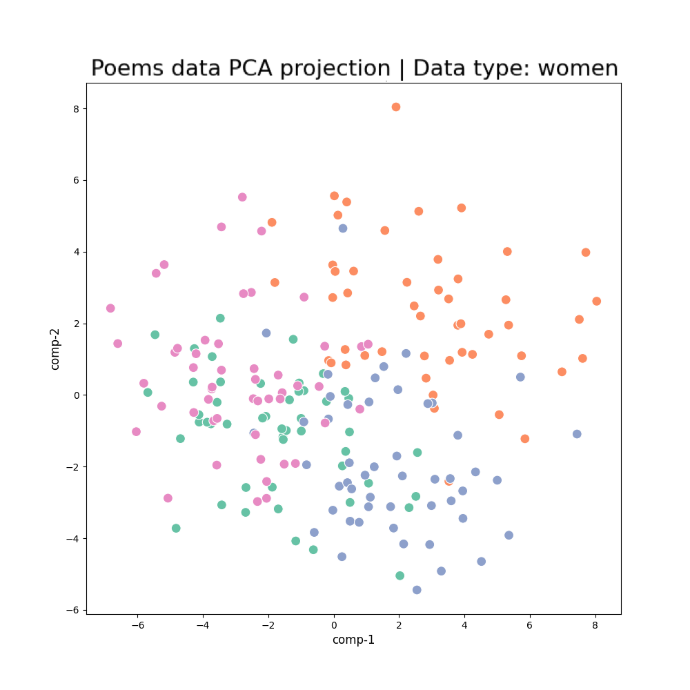
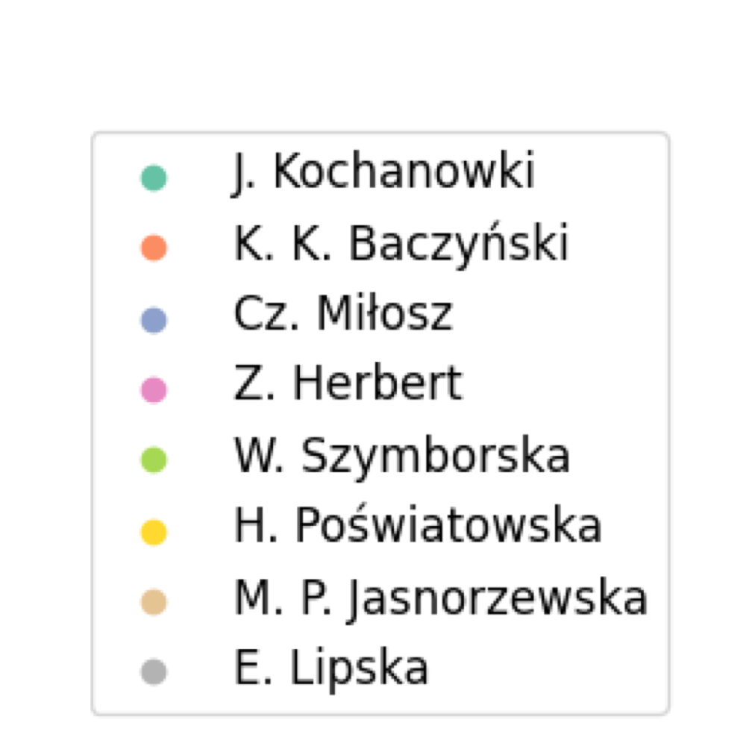
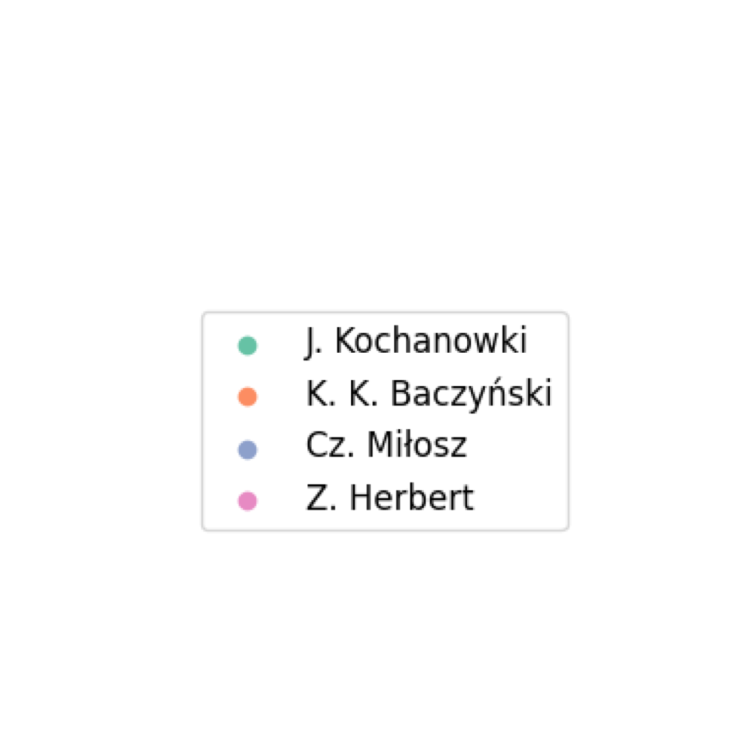
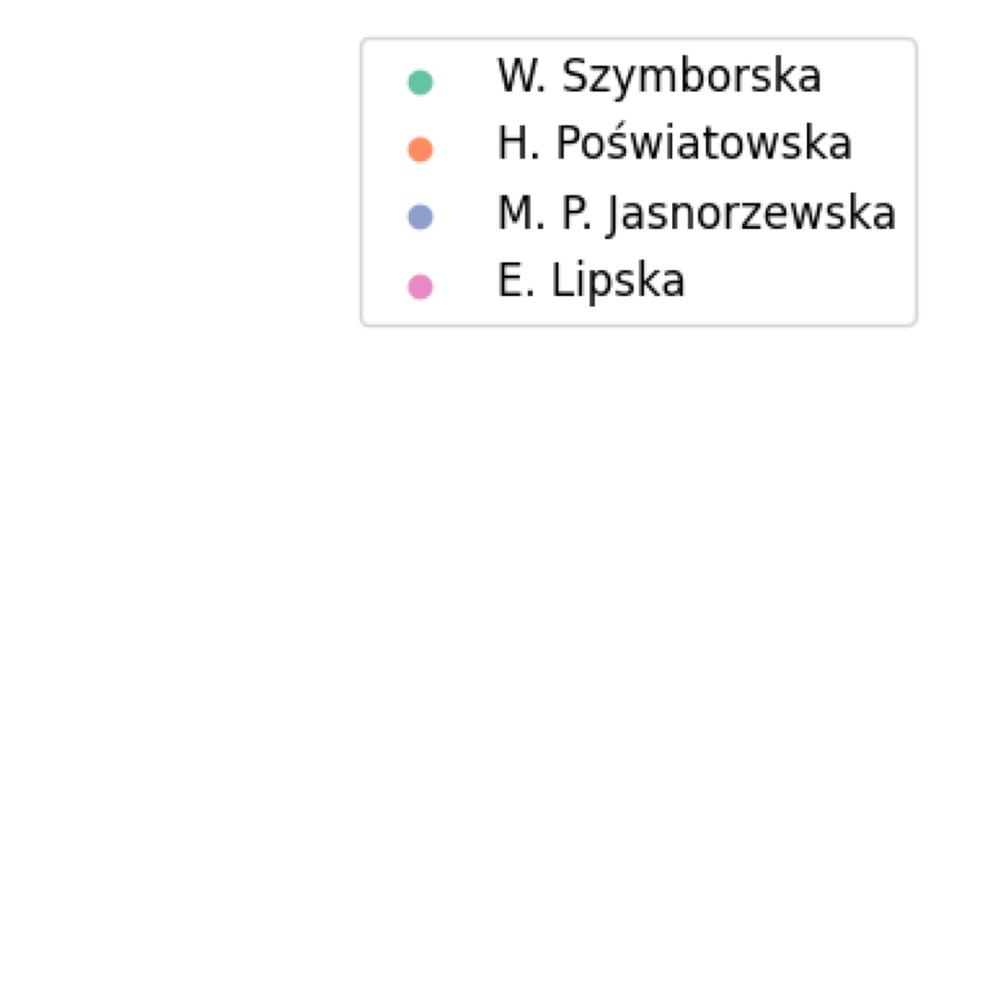
PCA clusters analysis

Slide 9
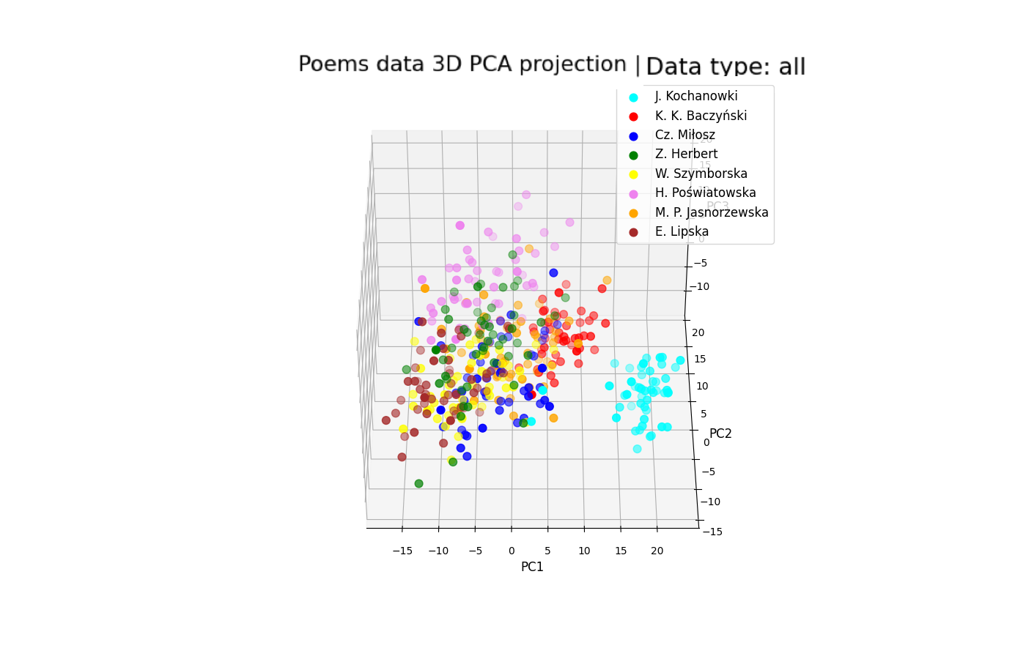
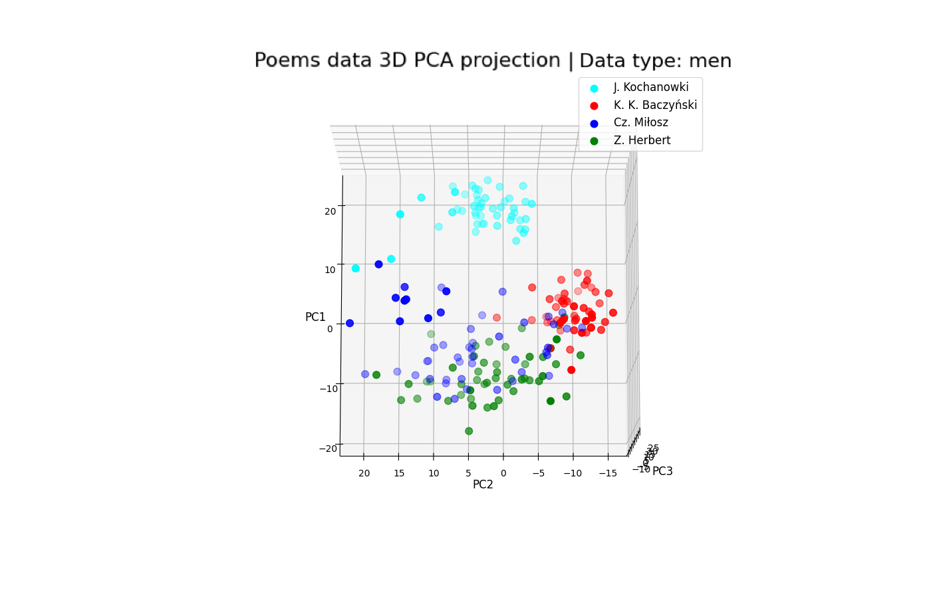
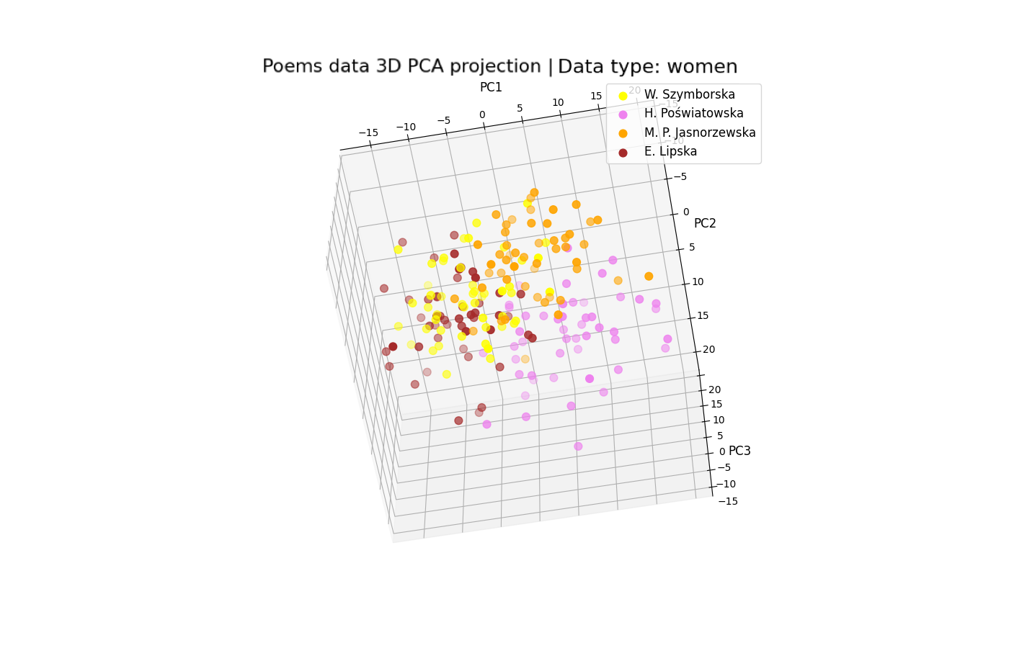
PCA 3D clusters analysis

Slide 10
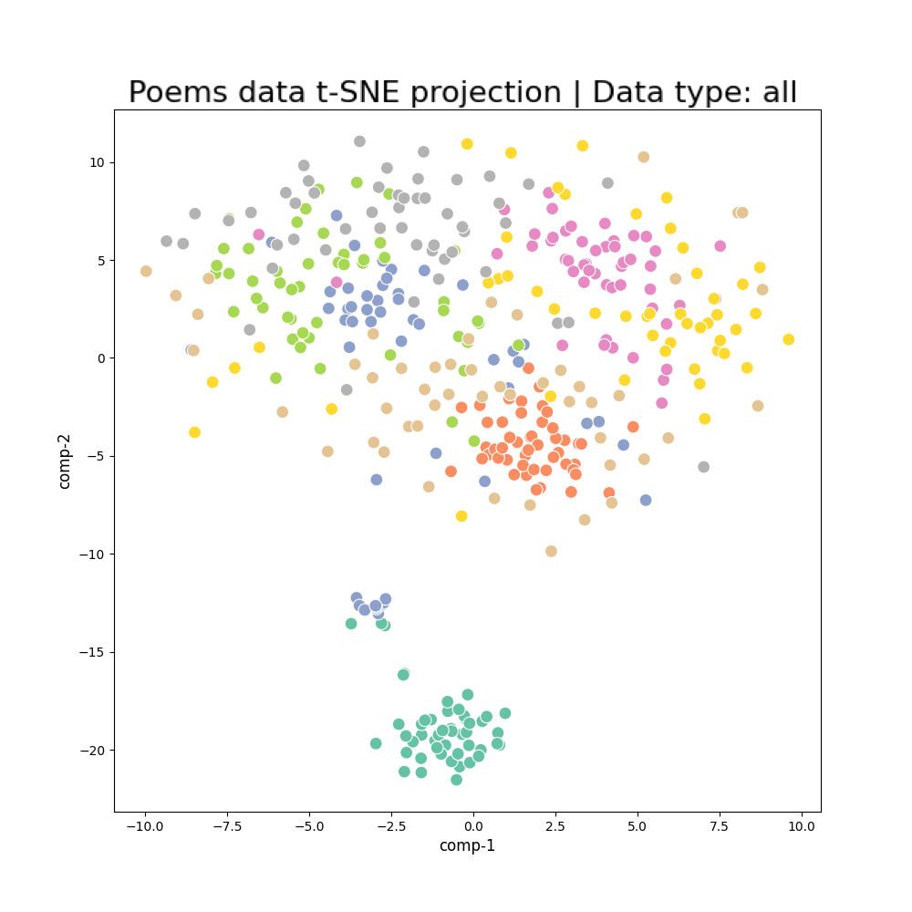
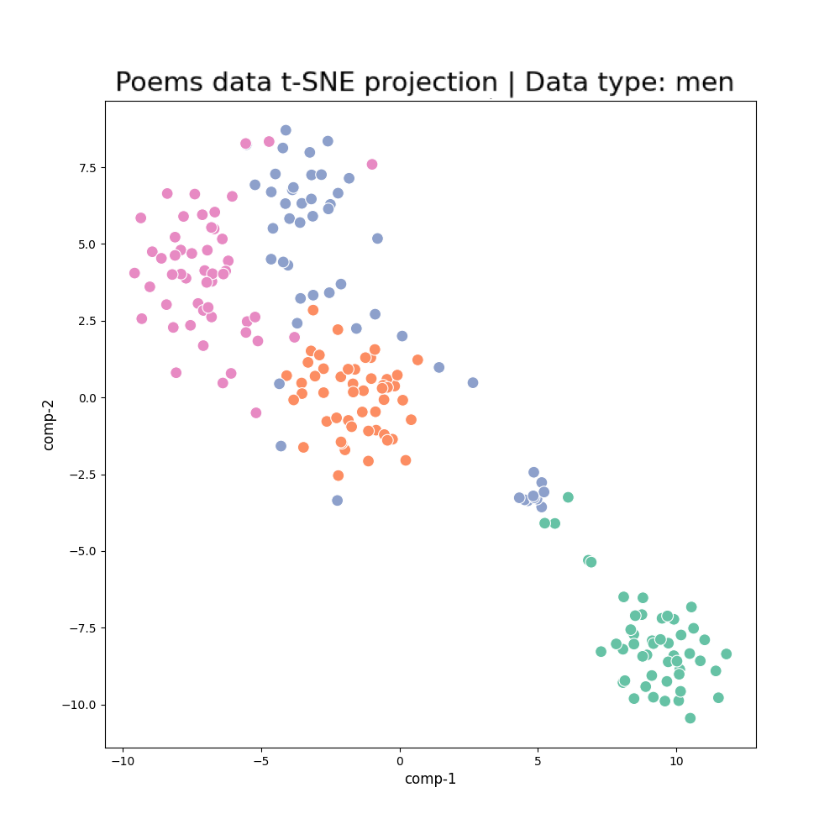
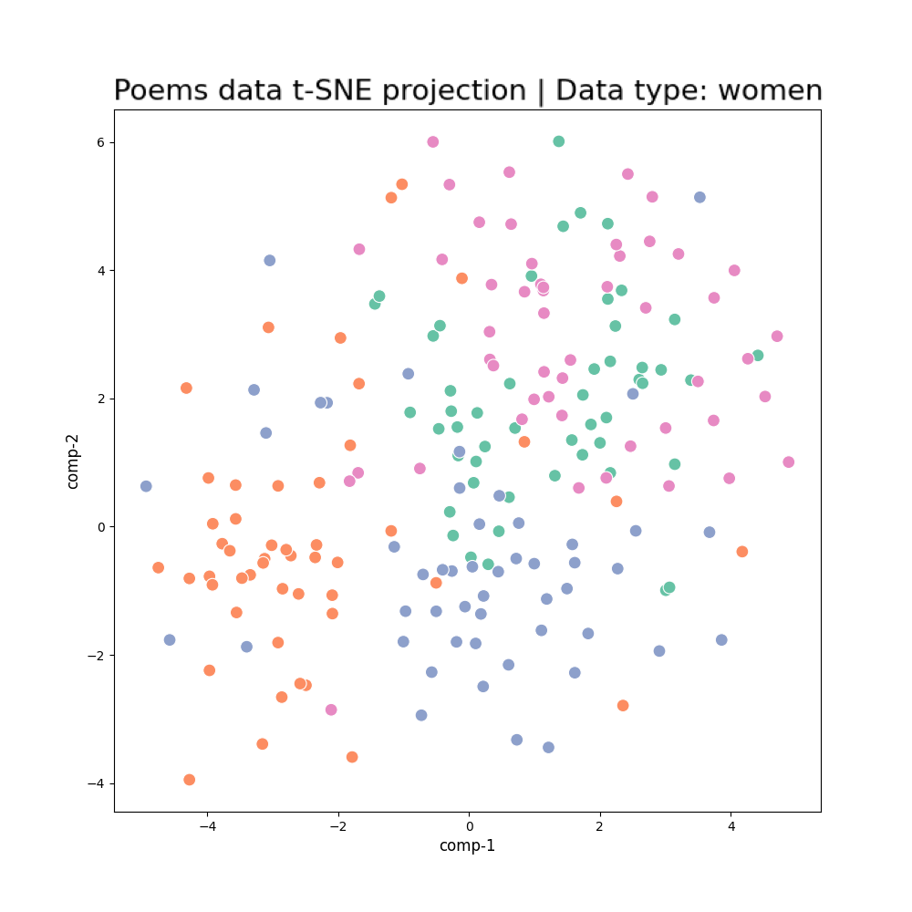
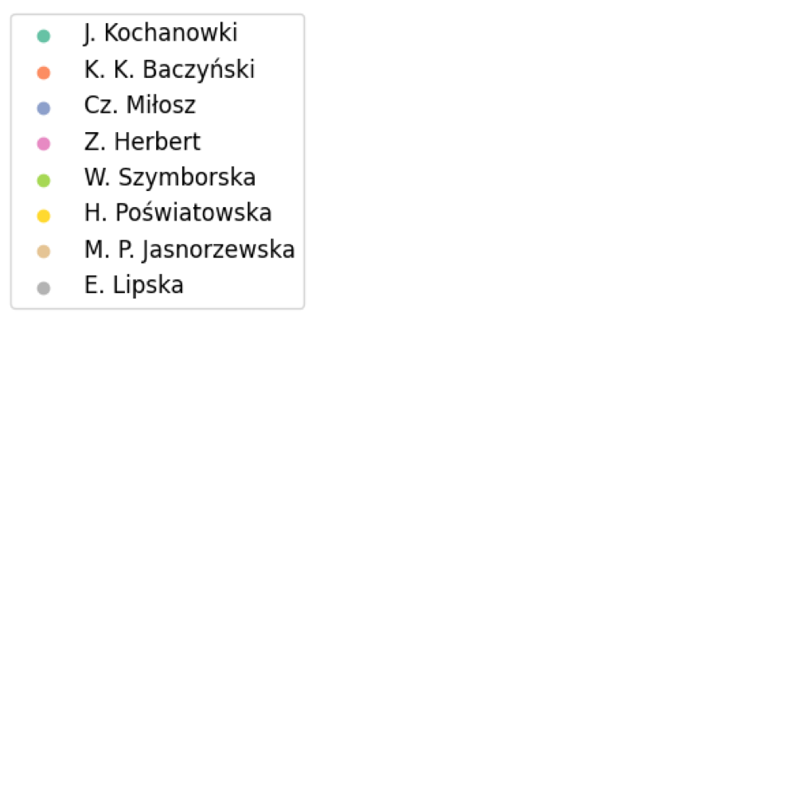
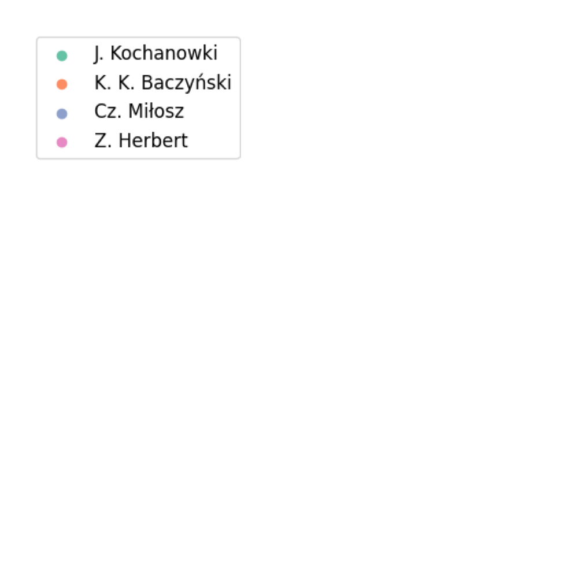
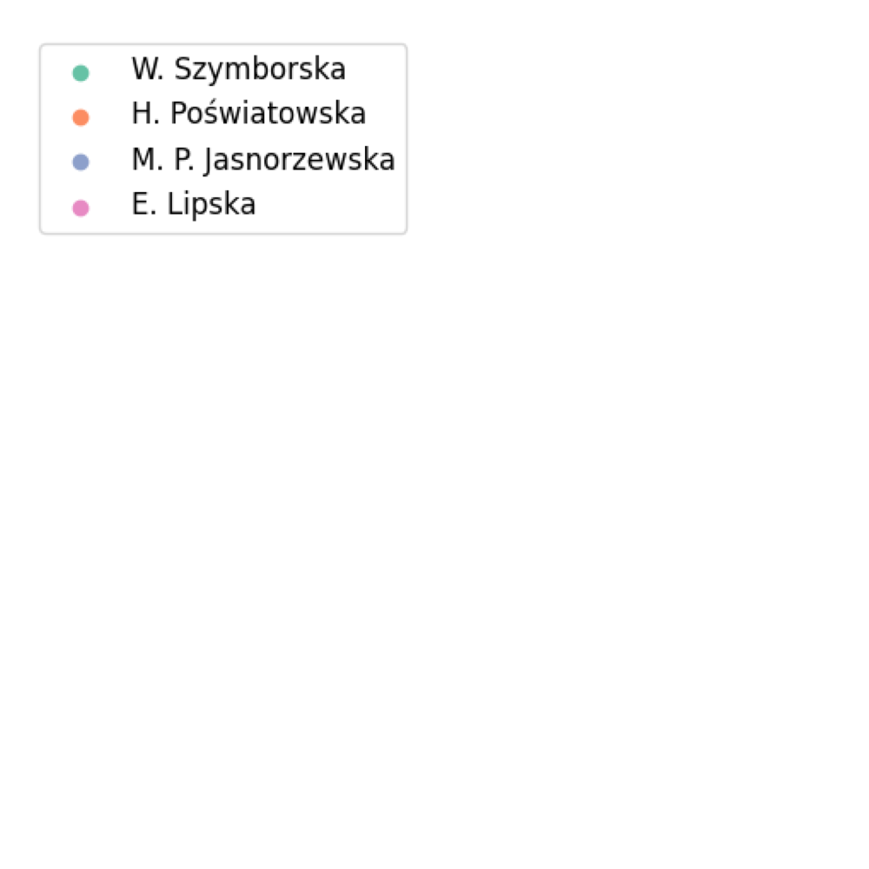
t-SNE clusters analysis

Slide 11
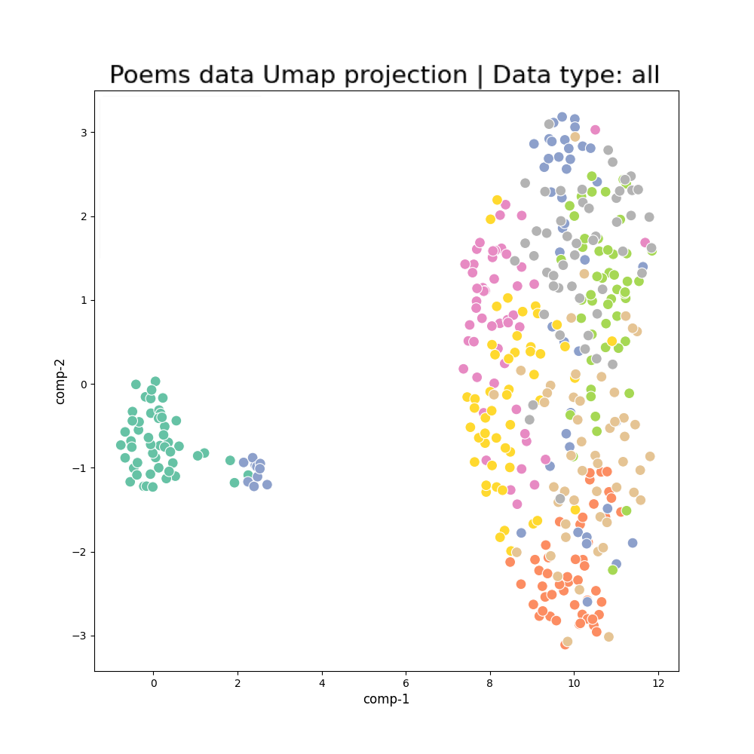
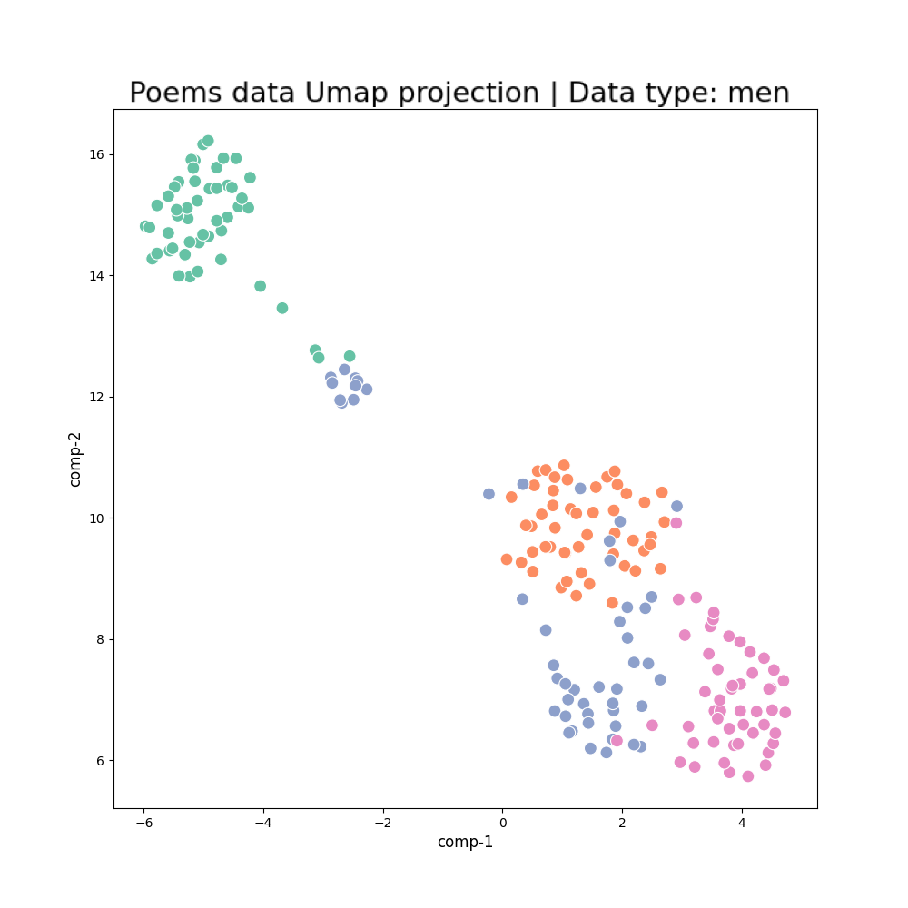
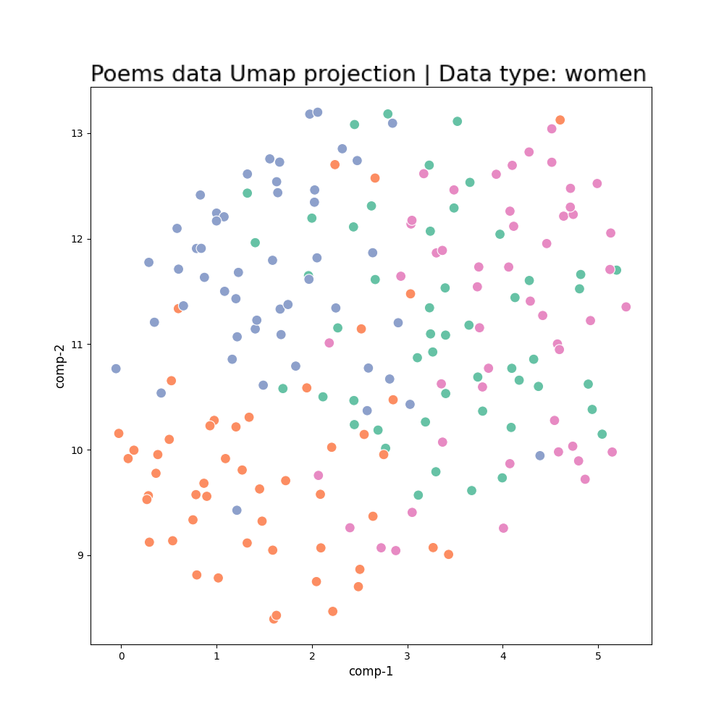
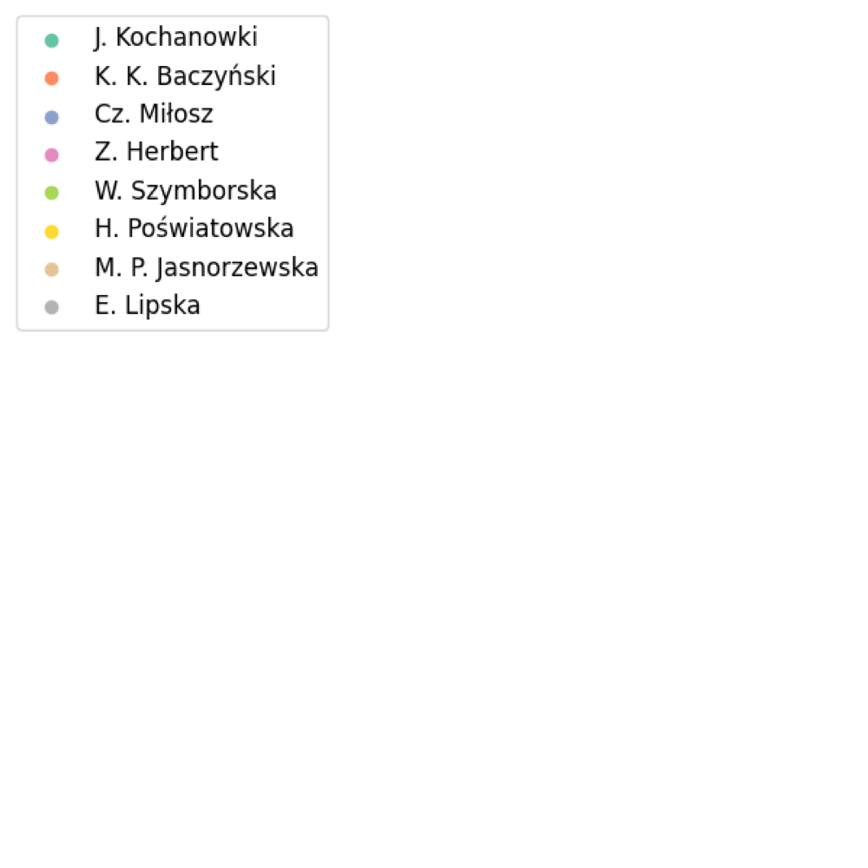
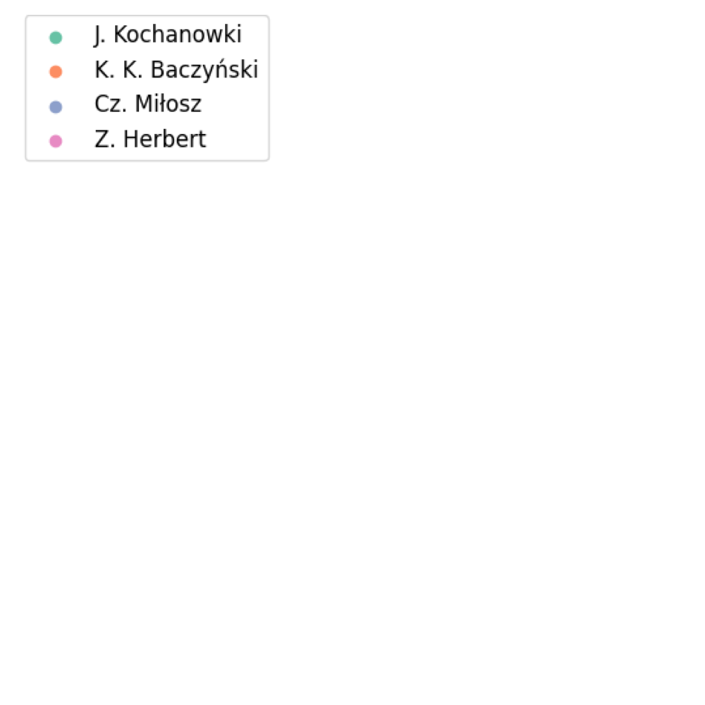
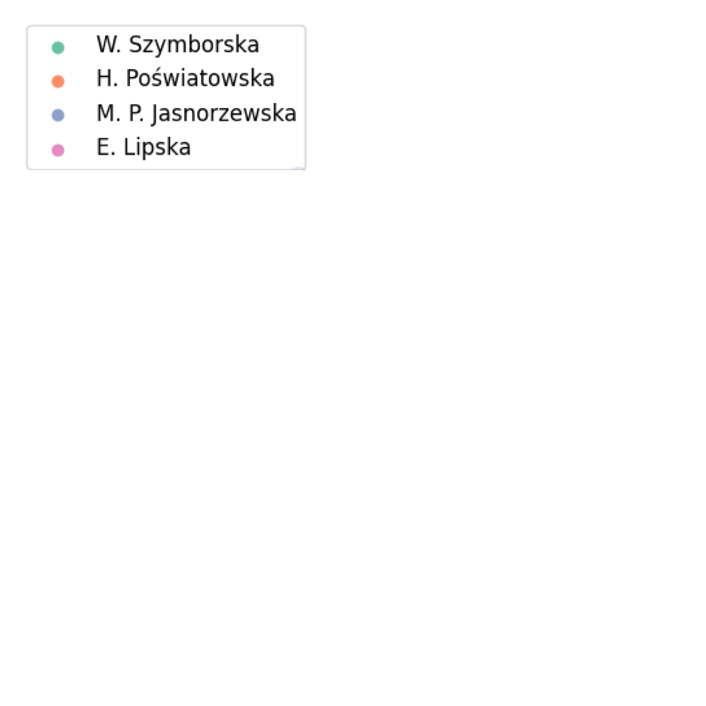
UMAP clusters analysis

Slide 12
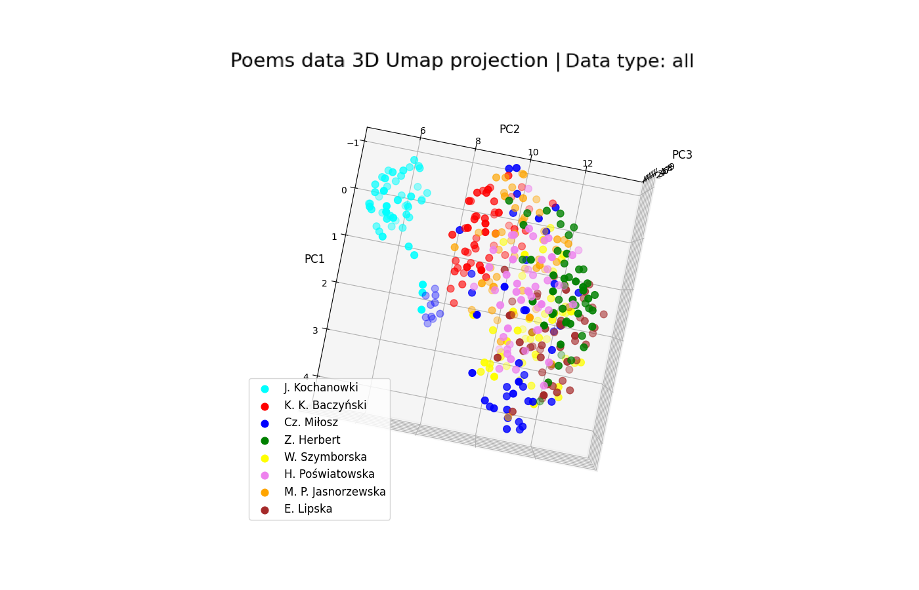
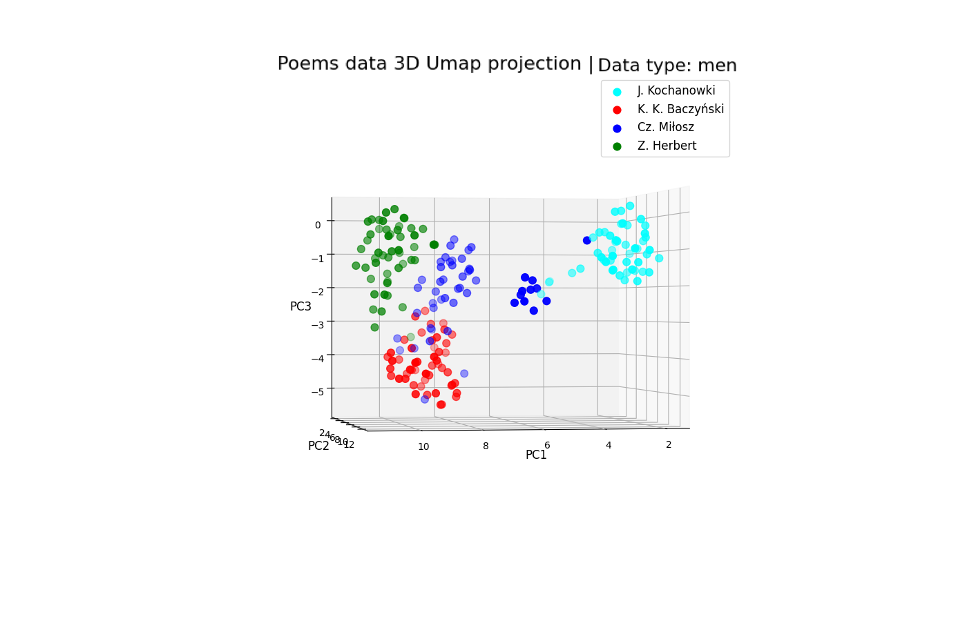
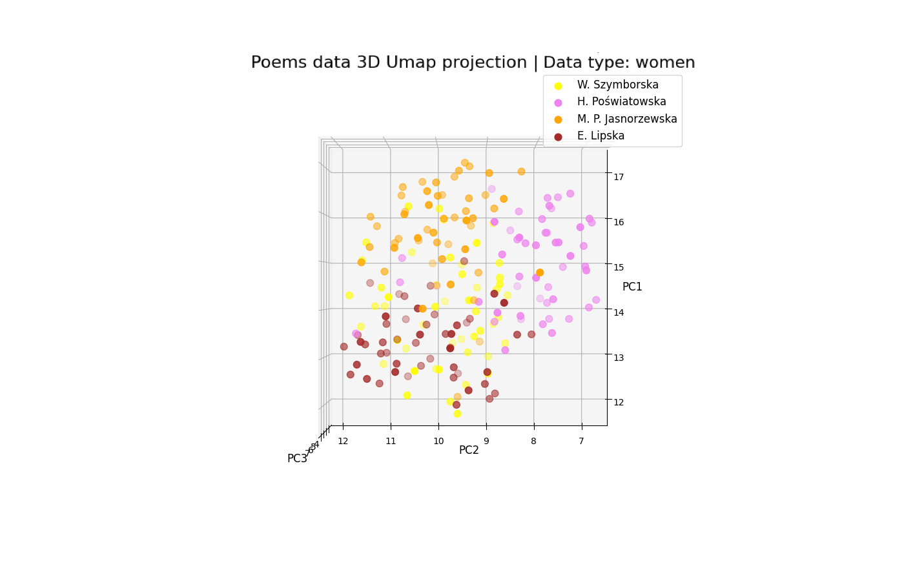
UMAP 3D clusters analysis

Slide 13
Plan:
Introduction a) Motivation and Objectives b) Tools and pipeline
Results
a) Unsupervised analysis: Dimensionality reduction and clustering analysis using PCA, t-SNE, and UMAP
b) Supervised learning - Nearest neighbour algorithm - Random Forest and ensemble method: XGBoost - Feedforward neural network
3. Conclusions and Outlook

Slide 14
Classifiers:
Nearest neighbour algorithm
Random Forest and ensemble method: XGBoost
Feedforward neural network
Training:
10 independent runs
metric: accuracy

Slide 15
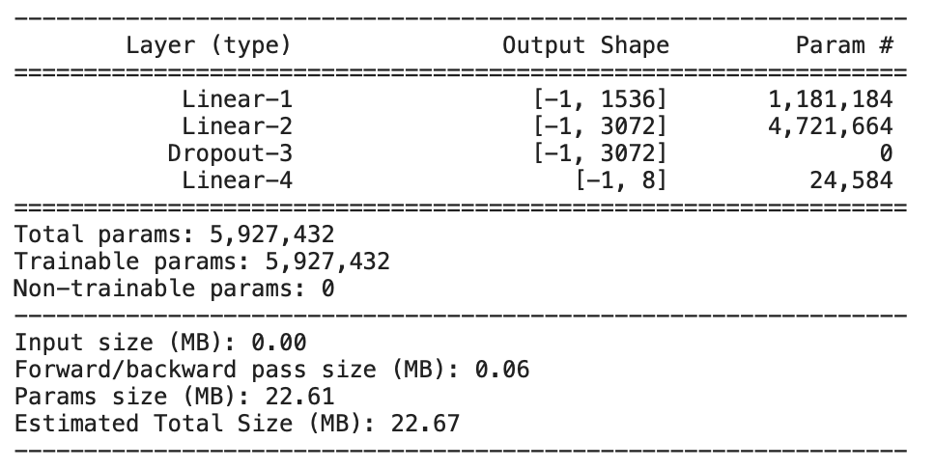
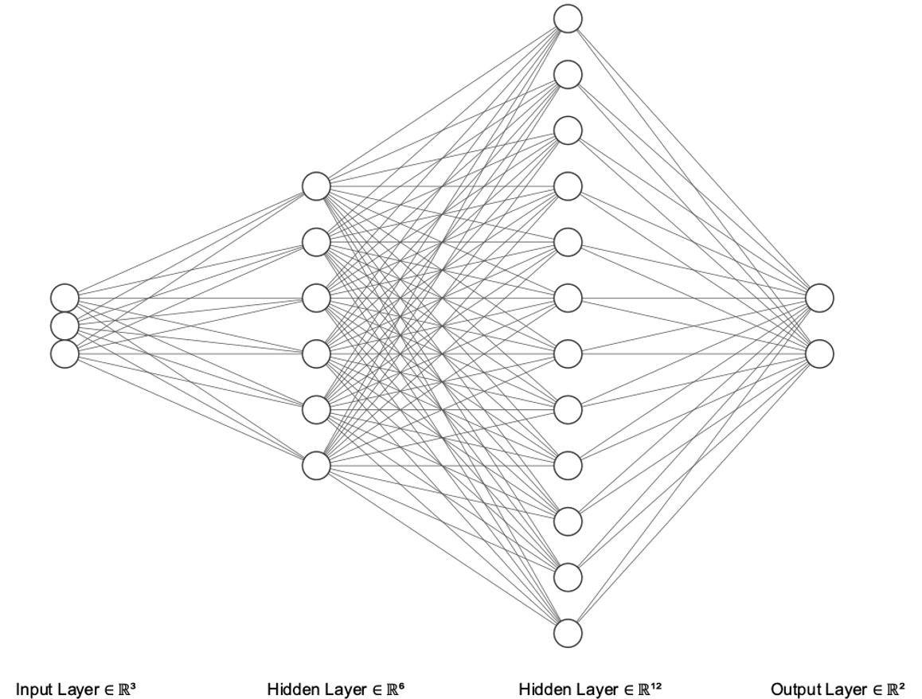
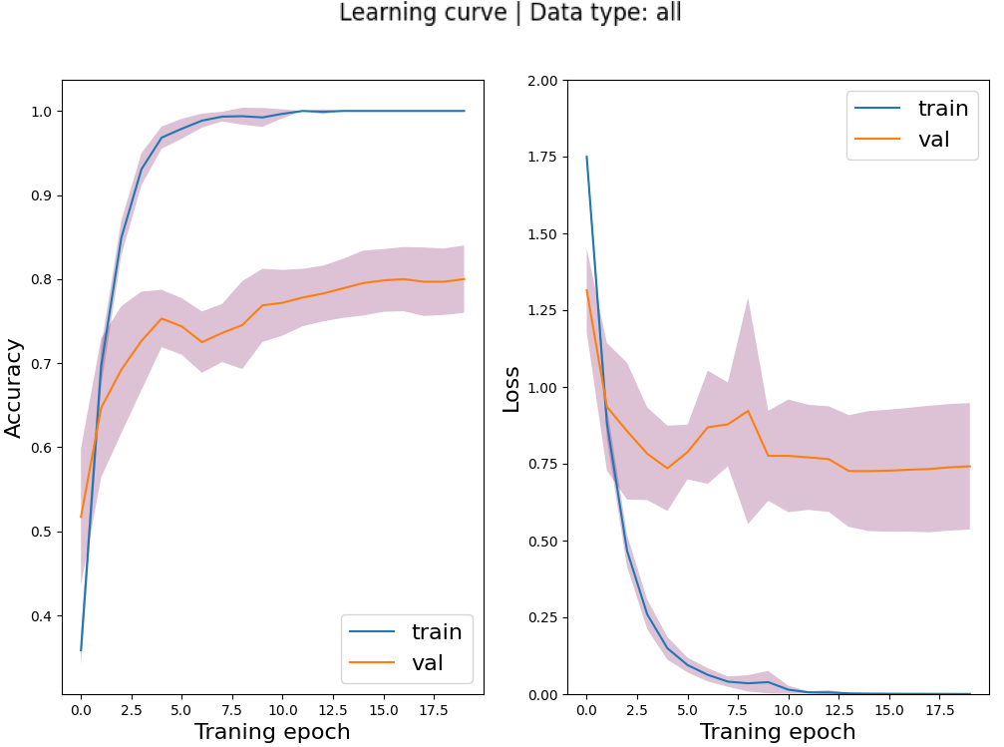
Neural network
Input shape = 768
Output shape = 8

Slide 16
Classification results

Slide 17
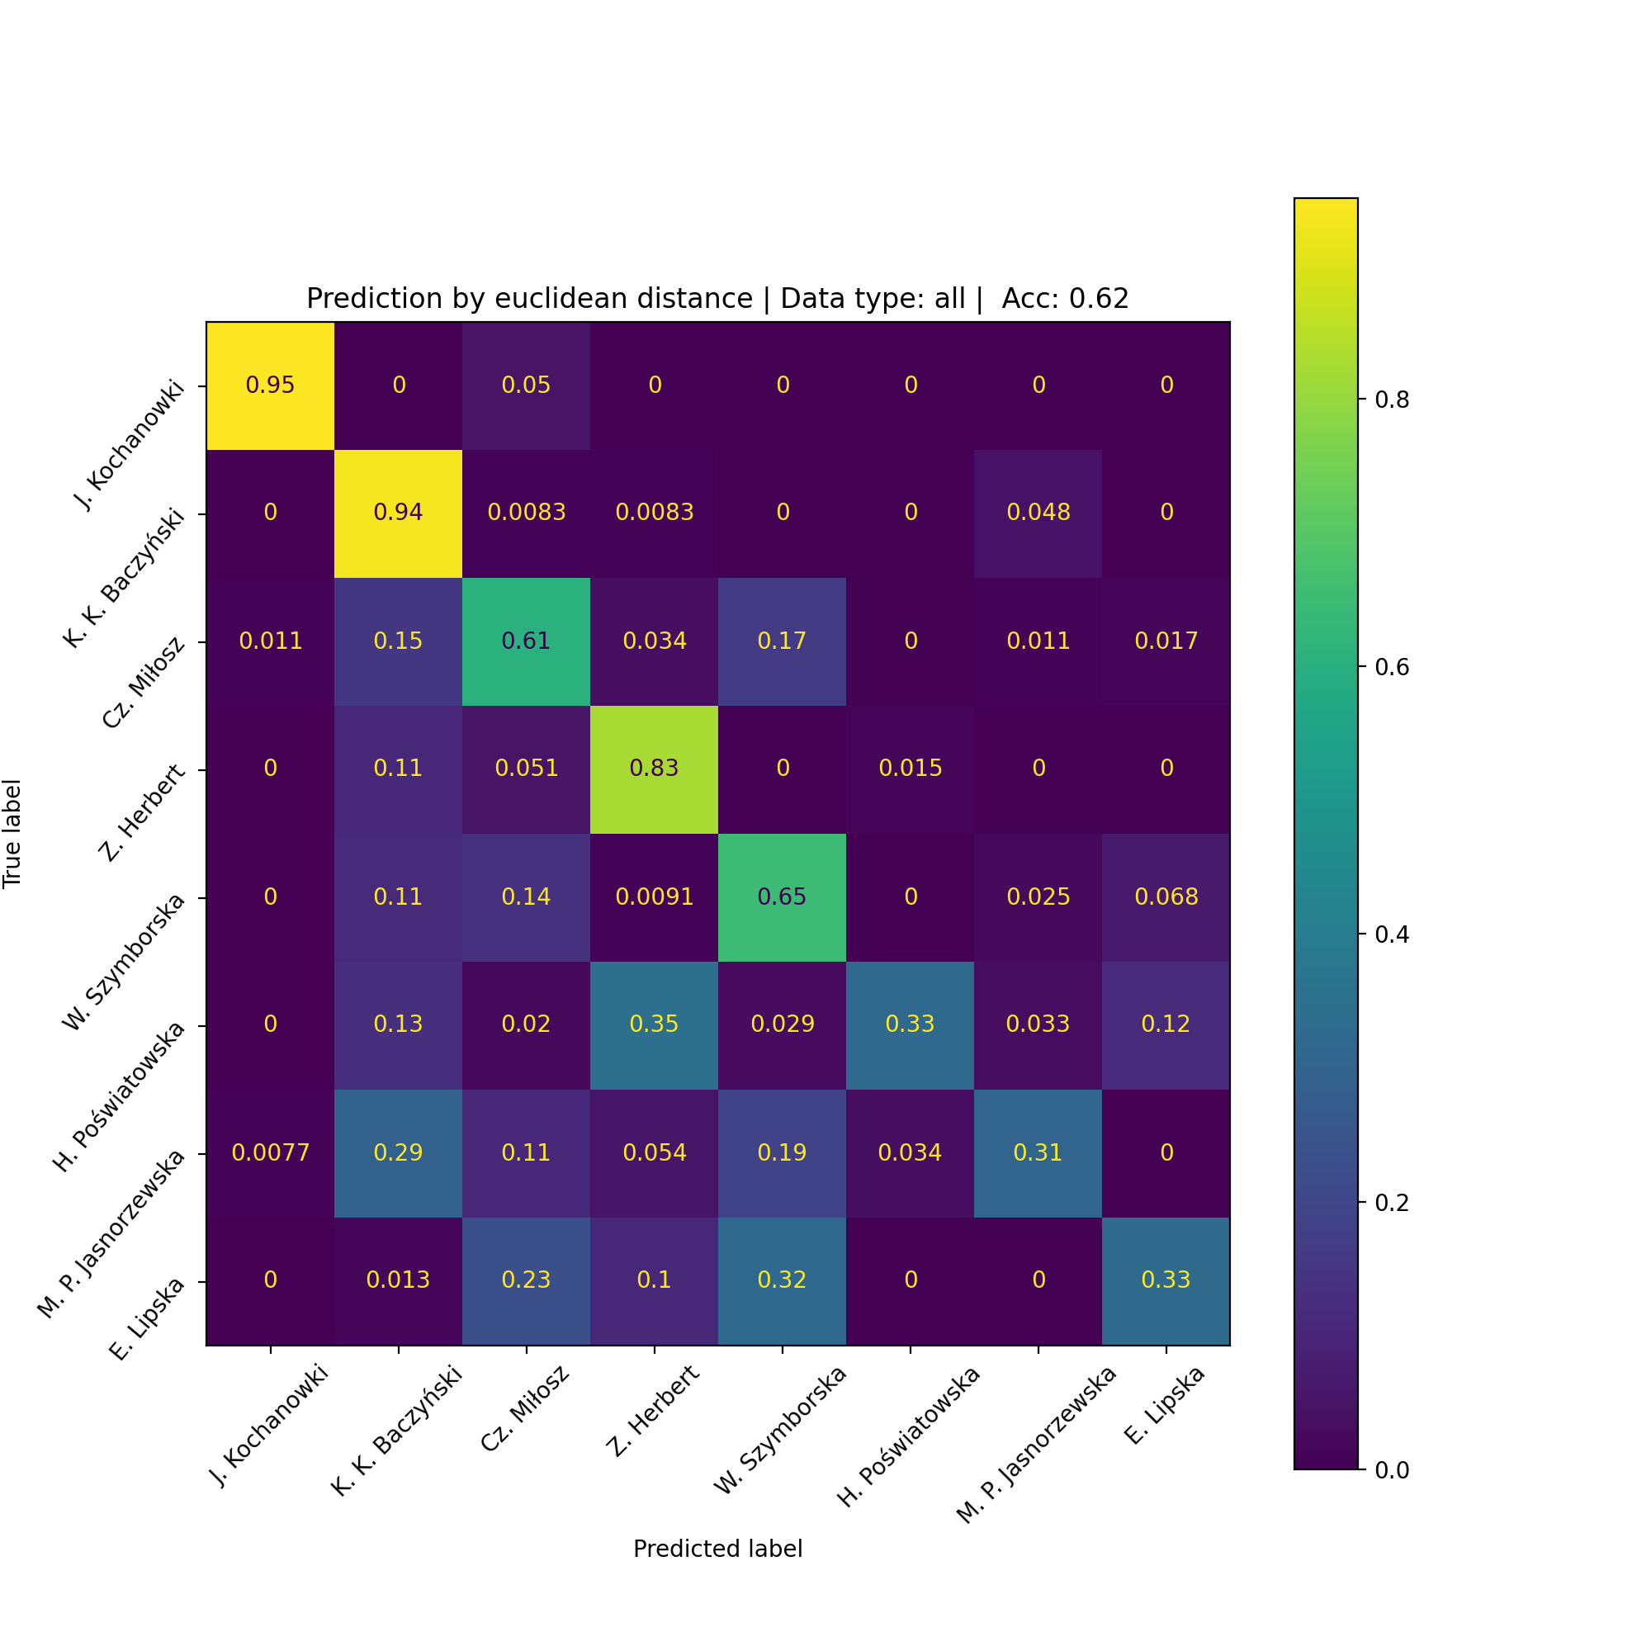
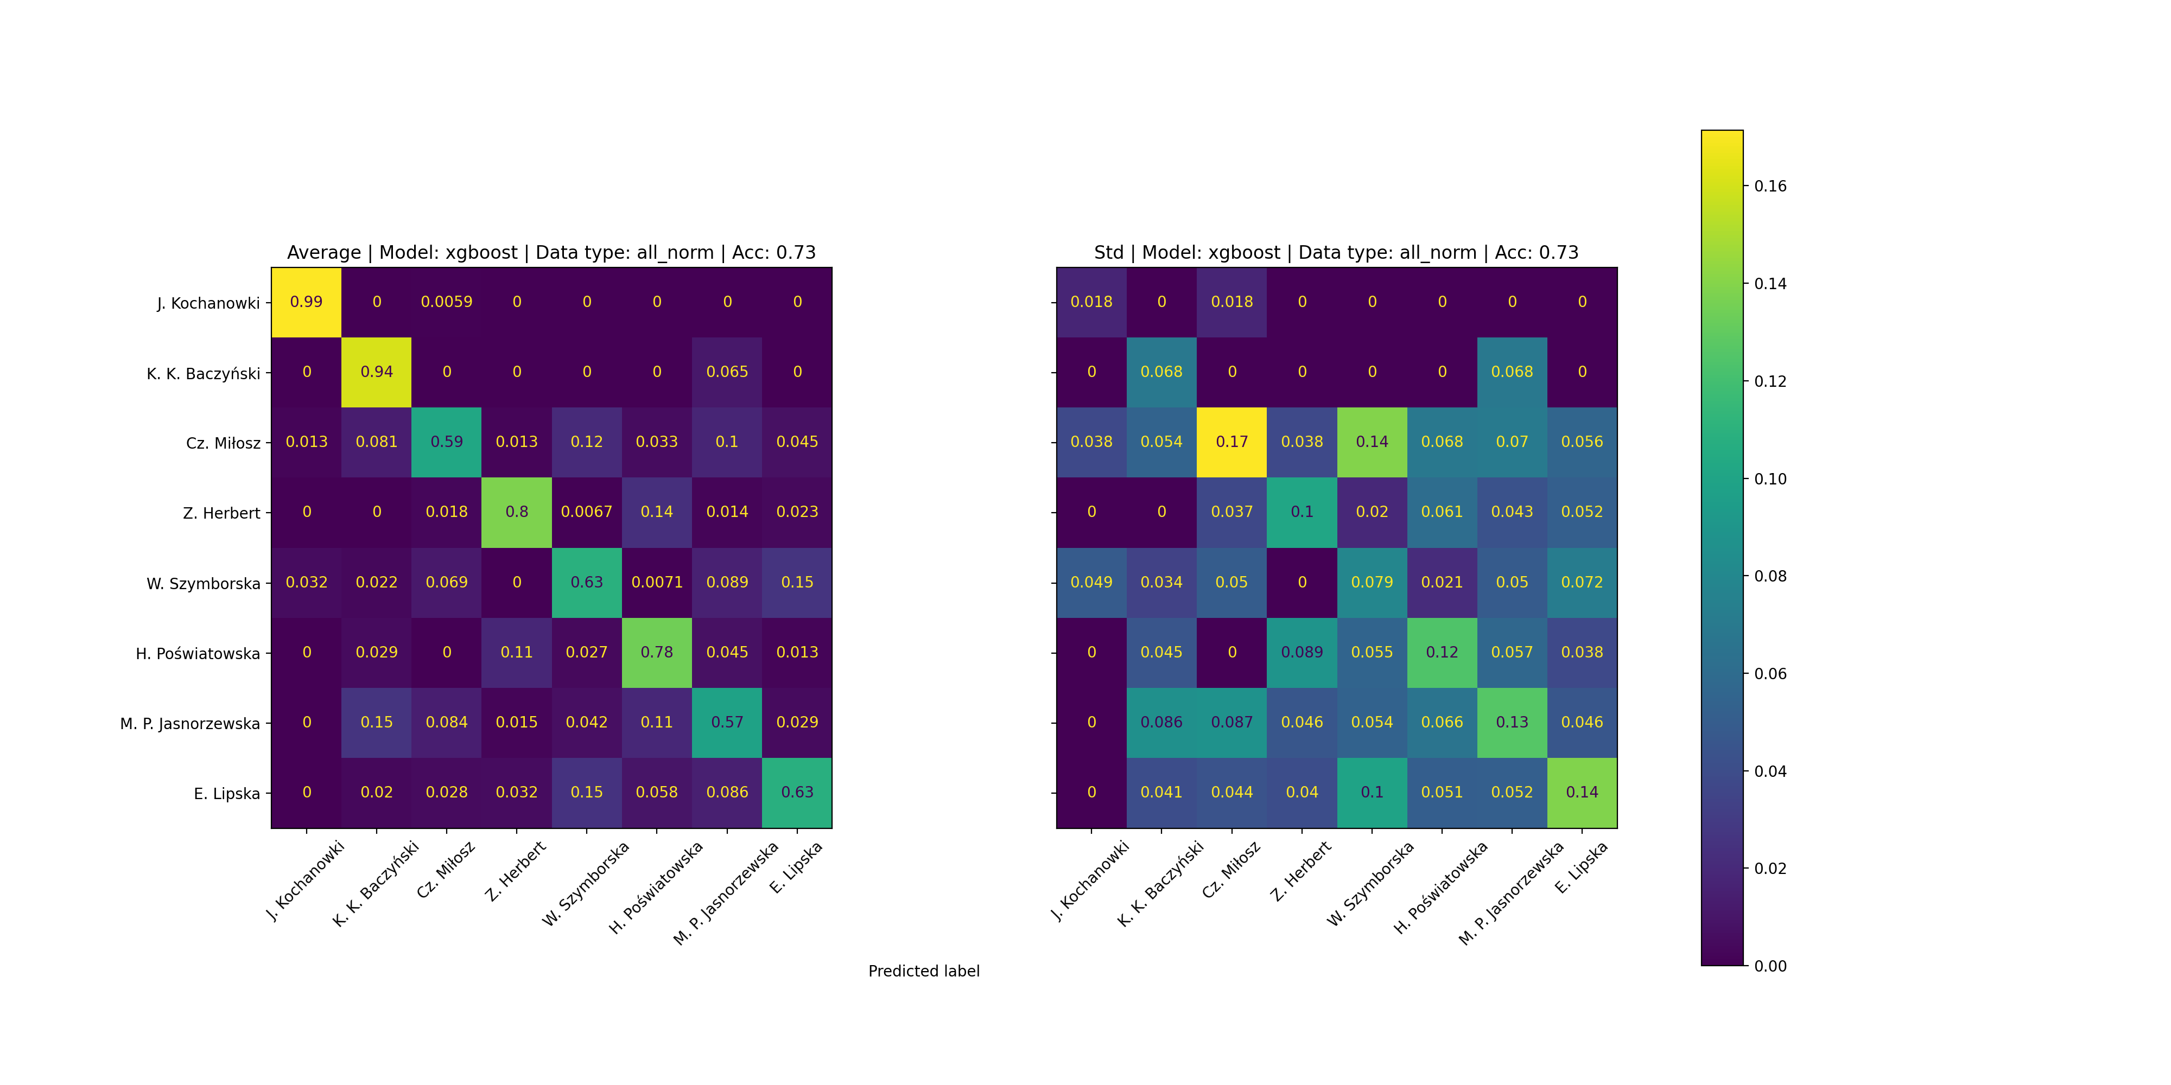
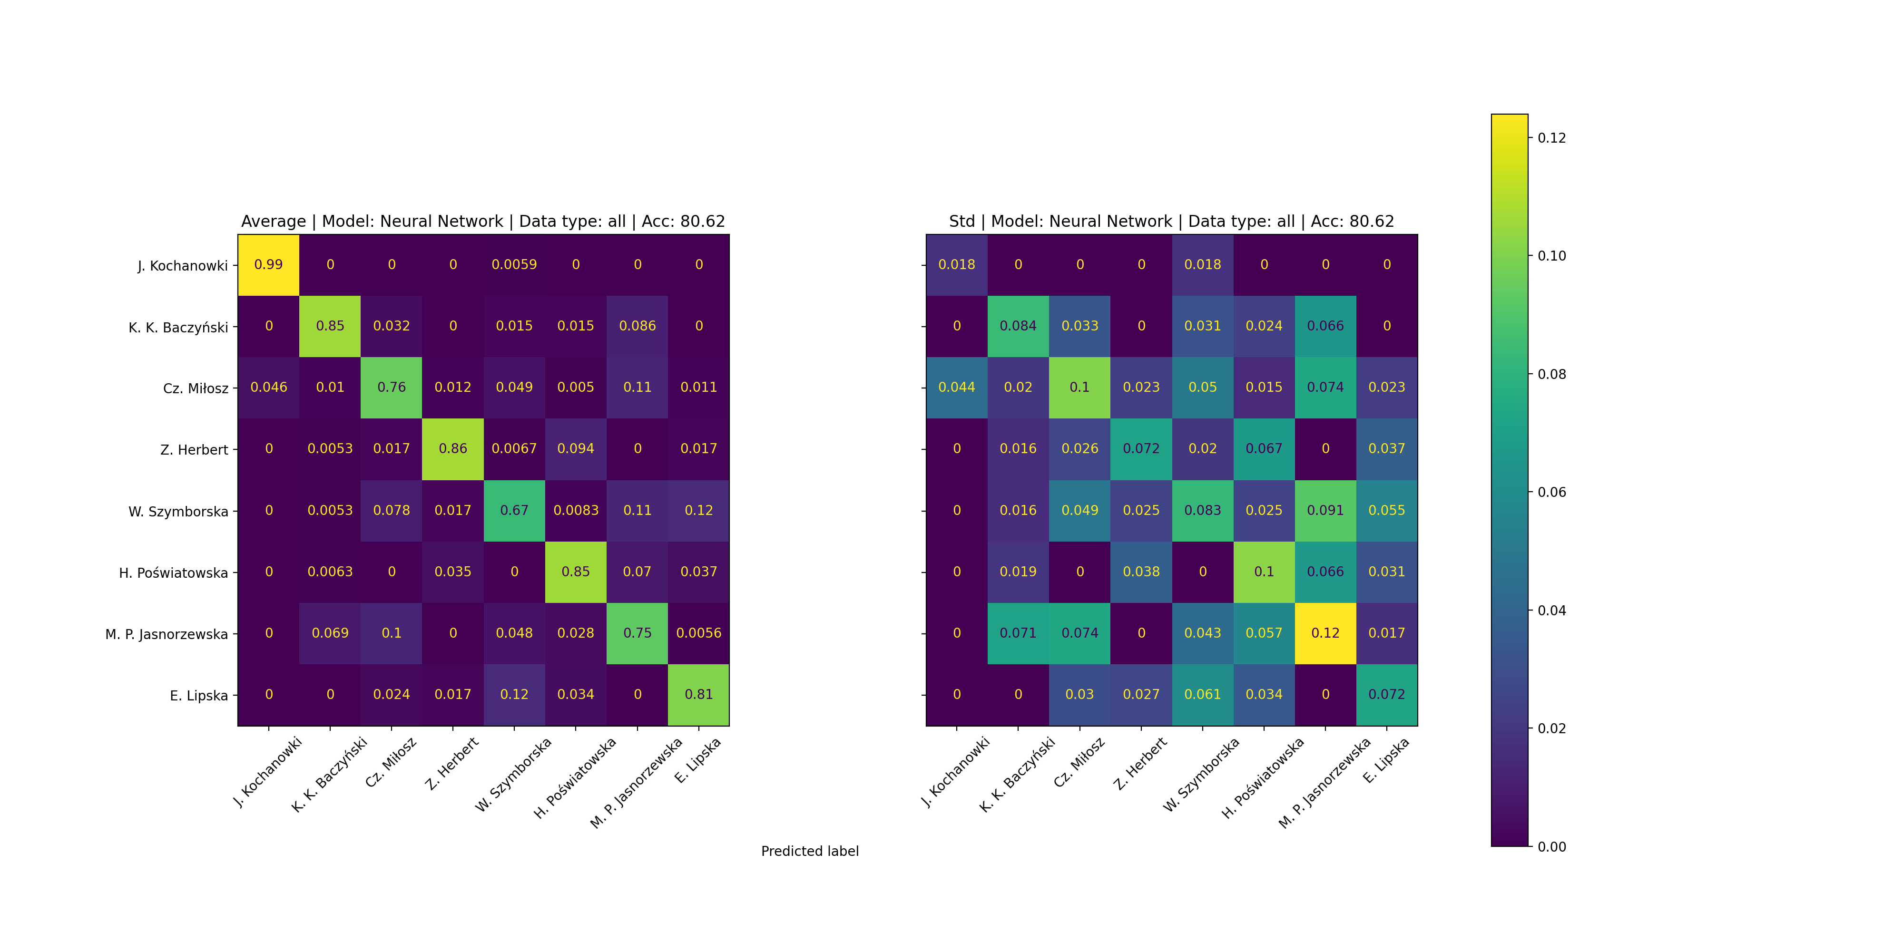
Confusion matrices
Nearest neighbour | Acc: 0.62
XGBoost | Acc: 0.73
Neural Network| Acc: 0.81

Slide 18
Plan:
Introduction a) Motivation and Objectives b) Tools and pipeline
Results
a) Unsupervised analysis: Dimensionality reduction and clustering analysis using PCA, t-SNE, and UMAP
b) Supervised learning - Nearest neighbour algorithm - XGBoost - Feedforward neural network
3. Conclusions and Outlook

Slide 19
Conclusions and outlook
Conclusions:
The best classifier: neural network
Female poets’ works are more challenging to classify. Male poetry is easier to classify
Analysis results are similar to literary knowledge
The challenge of working with literary:
multi-level conveyance of information in literary works, which can be interpreted in multiple ways
The development of NLP techniques can enable:
prevention in online hate speech
searching and identifying crimes

Slide 20
Thank you!

Slide 21
Back-up slide: Transformers architecture
Encoder:
Input Embedding Layer
Stack of 6 layers:
Multi-head Attention mechanism
FeedForward NN
Normalization function
Decoder:
Input Embedding Layer
Stack of 6 layers:
Masked Multi-head Attention mechanism
Multi-head Attention mechanism
FeedForward NN
Normalization function

